Slide 1

We Engineer your Digital Success
Proposal for Development of an Web/Mobile Product Cataloguing System for Fischer- UAE
Aug 2016
© 2016. All Rights Reserved / www.verbat.com

Slide 2

Contents
1
Background & Scope
2
Solution Overview
3
Application Functionality
4
Discovery Phase
5
Application Delivery
6
Technology Specification
7
Project Timeline
8
Deliverables
9
Commercials
10
Out of scope
11
Terms & Conditions

Slide 3
Background & Scope
REDA Safety has partnered with the industry’s leading manufacturers of safety equipment, materials and systems providing our customers with a full range of solutions. REDA Safety has the experience and knowledge to provide the products that bests fits the customers needs. REDA’s range of products include equipment's for body protection, Fire fighting & Fire protection.
Scope
REDA has contacted Verbat LTD. To develop an e-Commerce site that will cater to the needs of its established clientele. Additionally REDA also intends to marshal in new clients via SEO engagement activities. The Site needs to integrate with their customers ERP system ( for managing purchase orders) as well as its own Microsoft Dynamics CRM implementation ( for inventory management, Shipping & Returns). The site will be customized to provide special discounts to its VIP customers. Online payment systems using credit cards and bankcards will also be integrated.

Slide 4
Scope
REDA has contacted Verbat to develop an application with the following features:
Third-party Integration
Integration with customer’s ERP system
Integration with Microsoft Dynamics CRM
Integration with major credit card payment processors (including Saudi bank)
E-commerce site
Customer groups (VIP customers to get special discounts, Site admins, other clients)
Related products, suggestions & Product Wish list
Product comments and ratings
Unlimited Product categories, listings & unlimited manufacturers.
Product search with filters (includes American and European standards)
Responsive design ( reference site: something.com) with SEO optimization

Slide 5
Scope (Continued)
Admin Features
Add new Categories and Products (Product uploads)
Create discounts for VIP customers (including discount coupons for non VIP customers)
Analytics, event notification system and reporting
Printable invoices
Multiple Tax rates & Multi Currency
Intuitive Dashboards
Site Security
Fraud detection system
PCI compliant
Error logging
Multi-factor authentication

Slide 6
Solution Overview

Slide 7
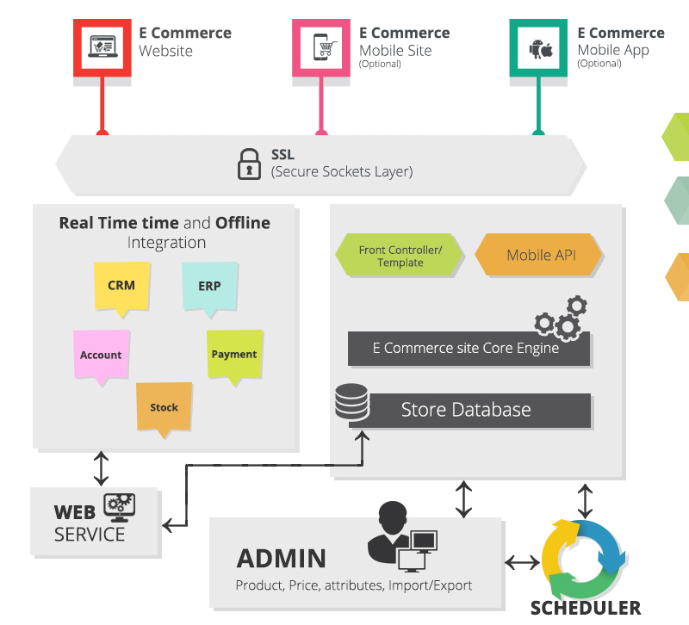
Solution Overview
E-Commerce site with multiple Access points
Real time and Offline integration with back office functions
Communication via SSL & HTTPS
Admin Dashboard for managing the store and real time analytics
Scheduler for maintenance activities

Slide 8
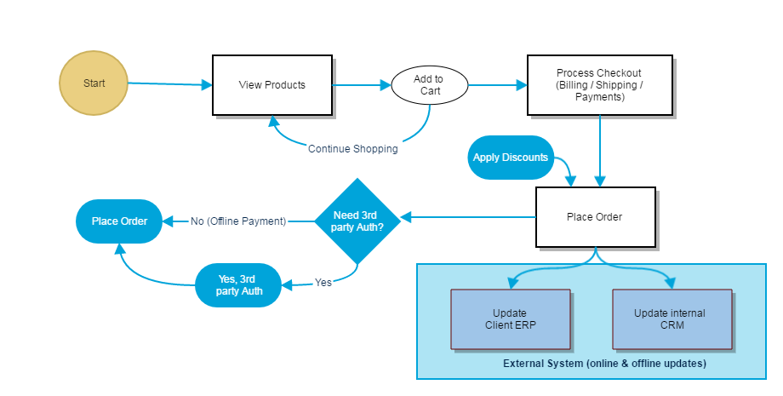
Purchase Work Flow

Slide 9
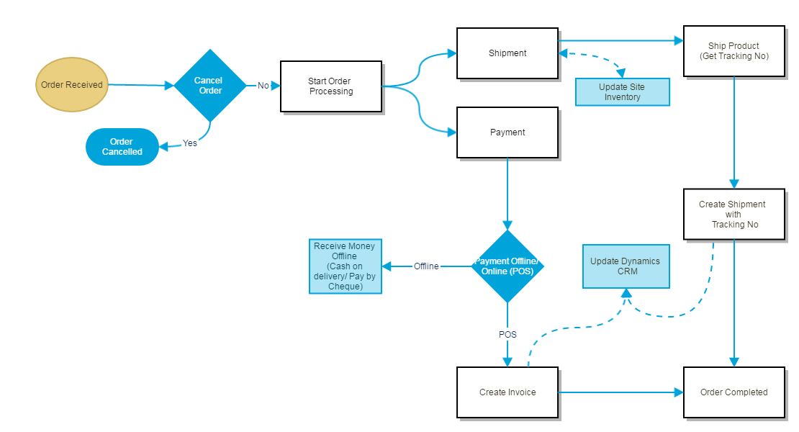
Order Work Flow

Slide 10
Application Functionality

Slide 11
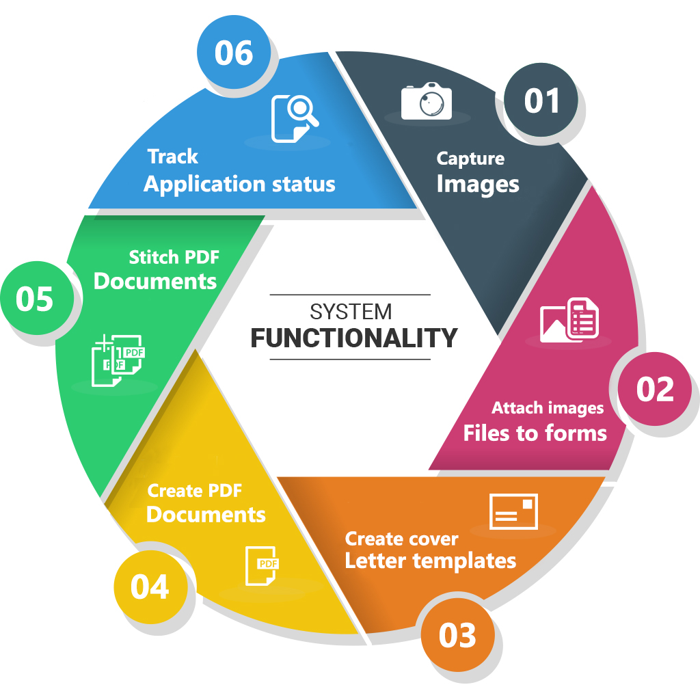
General Application Functionality
Product, Order, Inventory & User Management
MIS Reports & Analytics
Loyalty, Campaign management
Upselling & cross selling Services
Payment services
Personalization & Custom Search services

Slide 12
Feature Details
Reports
Marketing Report (marketing, Affiliates)
Sales Report (orders, Tax, Shipping, Returns, Coupons)
Customer Report (Customers online, activity, rewards)
Product Reports
Admin Dashboard
Uploads, Backups & restores, Error Logs
Create & manage Users, User Groups
Localization (currency, time zones, Taxes)
Manage Stock status, order status returns, countries
Configure Marketing( affiliates, coupons, mails)
Configure Sales (orders, recurring orders, Returns, Customers, Gift vouchers)
Configure Manufacturers, Categories, Products with attributes)
Configure information (about us, privacy etc.)
Customer Web front
Create Profile
Search products using filters
Multiple payment methods
Create reviews, Ratings for products
Related products, suggestions and featured products
Avail discounts, coupons & gift vouchers.
Integration
Major payment gateways
External client applications
Internal CRM applications
HTTPS, Mail & marketing campaigns

Slide 13
Discovery Phase

Slide 14
Requirements Gathering
On signing the contract, Verbat will deploy a senior Business Analyst to discuss the business and technical requirements, define the solution approach, deliverables during each phases of execution, documentation and sign-off
Deliverables
High level technical design
Detailed requirement specification document
Wireframes for the key screens for the proposed web application
Dependencies
The client to nominate a Point of contact to coordinate with our team
Availability of key stakeholders for meetings to discuss requirements and validate findings and deliverables
Written sign-off on the deliverables prior to commencement of the development phase

Slide 15
Application Delivery

Slide 16
Application Delivery
Application will be delivered in three phases. Development will start post approval and sign-off of the Software Requirements Specification (SRS) by the client. The deliverables for each phase is listed below.
Phase 1 Delivery
Includes general application framework that consist of modules like authentication and authorization, Logging, API integration, Master data Maintenance, Splash Screen
Initiate approval workflow
Create request for approvals (draft and final)
Theme development for mobile devices and web
Database design and development

Slide 17
Application Delivery (Contd.)
Phase 2 Delivery
Approval workflow to approve request
Complete the approval copies (with additional information and attachments)
Create PDF documents
Complete product data features and relate it with approval copies and submittal forms so that they can be searchable
Phase 3 Delivery
Completion of the application and company submittals
Convert attachments to PDF documents
Stitch cover letter and attachments to create a PDF document

Slide 18
Technology Specification

Slide 19
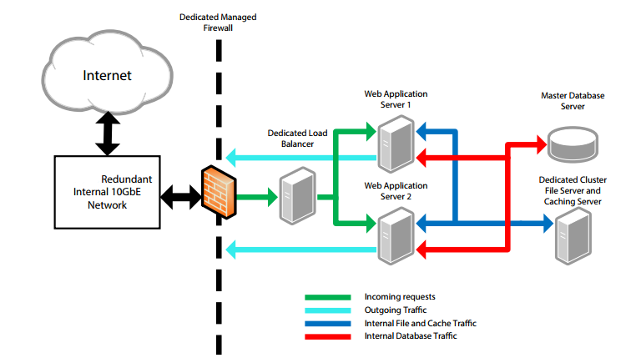
Technology Specifications

Slide 20
Web Application Servers: Dell R420 2x Intel Xeon 8 Core CPUs E5-2450 @ 2.10GHz 24GB RAM 2x 147GB 15K SAS RAID-1 (H710)
Database Server: Dell R420 2x Intel Xeon 6 Core CPUs E5-2420 @ 1.90GHz 24GB Ram 4x 147GB 15K SAS RAID-10 (H710)
File Server / Caching Server: Dell R420 2x Intel Xeon 6 Core CPUs E5-2420 @ 1.90GHz 24GB Ram 4x 147GB 15K SAS RAID-10 (H710)
Load Balancer: Dell R420 2x Intel Xeon 6 Core CPUs E5-2420 @ 1.90GHz 16GB Ram 2x 73GB 15K SAS RAID-1 (H710)
PHP 5.4 for Magento
PHP-FPM (FastCGI Process Manager) for a scalable performance boost
Nginx web server: fast, lightweight and reliable
Redis for shared session storage
HAProxy for load balancing

Slide 21
Project Timeline & Commercials

Slide 22
Project Time line & Deliverables
The time estimated for delivering the application is 33 working man days
Activity | Timeline (Days)
Requirement Gathering Complete and Sign-Off(T0) | T0
Software requirement Specification | T0 + 1.5
Theme Selection & Application Prototype | T0 + 1.5
Prototype Approval | T1
Functional Specification Document | T1+1
Development Start | T2
Development Phase 1 | T2 + 9
Development Phase 2 | T2 + 8
Development Phase 3 | T2 + 7
Quality Assurance | T3 + 4*
UAT | T4
Go Live | T4 + 1
Deliverables
Software Requirement Specification (SRS)
High level technical design
Wireframes for the key screens
UI/UX Theme
Functional Specification Document (FS)
Test plans & Test cases
User Manual (English)
Fully developed and tested application for deployment (Phase 1)
Additional 2 days needed for regression testing*

Slide 23
Commercials
Sl. | Description | Cost
01. | Development of Web/Mobile Product Cataloguing System | USD 00,000
02. | Hosting of the Application in Dedicated Server | USD 800.00/Monthly

Slide 24
Out of Scope

Slide 25
Out of Scope
Any other language other than English
Content / Image procurement or uploading or editing
Purchase of 3rd Party PDF SDK
Manual data entry
Integration to existing application (if any)
Database migration
Physical deployment at client’s site
Purchase of SSL
Backup solution and Disaster recovery for hosting (Can be provided for additional price)
Content writing
Third party software integration
Annual Maintenance Contract

Slide 26
Terms & Conditions

Slide 27
Terms & Conditions
Offer Valid for 30 calendar days from the date of submission of the Proposal
An average of 20 working days are assumed in a month
This proposal and all technical/ functional specifications have been derived or concluded from the data shared via email / information's transferred during the initial requirement analysis meetings and conversations. Verbat reserves the right to amend the terms of this proposal, should the SOW terms, functional features and functionalities change during the course of the project
Client need to provide the Google Play store & Apple App store credentials to Verbat
Client need to buy 3rd party PDF SDK, as recommended by Verbat
The applications will be built as per the specifications agreed mutually. Any changes will be executed through a deﬁned change management process between both parties
All Source Code and other project artefacts would adhere to the Verbat document templates and internal coding standards
Verbat will provide a bug ﬁx warranty at no additional cost for 30 days from the date of acceptance of the project, for correction of any errors in the developed application that may be attributed to Verbat
Acceptance criteria will be based on the clauses which were mutually discussed between Verbat and client at the Requirement Analysis phase and the same will be documented and approved by both parties through official emails

Slide 28



Contact Us
217, Sheikh Rashid Bldg
P.O Box 56272, Dubai United Arab Emirates
+971 04 2973236
Lekshmi.krishna@verbat.com
USA 2033 Gateway Place
Suite 500
San Jose , CA- 95110
India
Verbat Technologies (India) Pvt. Ltd. Level 3, PTC Tower Trivandrum, Kerala

Slide 29

Thank You
© 2016. All Rights Reserved Verbanet Technologies LLC www.verbat.com

